Slide 1

Ecommerce Data Analysis: Key Insights
This presentation explores the key metrics and trends within our e-commerce database. We will delve into financial performance, product profitability, and time-based sales patterns to uncover actionable insights.
SC
by Sarthak Chaudhary

Slide 2
Database Initialization & Basic Querying
Database Setup
Initial Data View
CREATE DATABASE Ecommerce; USE Ecommerce;
SELECT * FROM orders;
First, we create and select our e-commerce database. This sets the stage for all subsequent data operations and analysis.
This command retrieves all records from the 'orders' table. It provides a foundational overview of the data structure and content.

Slide 3

Key Performance Indicator (KPI) Analysis
$24.8M
Total Revenue
The sum of all sales before discounts.
$8.3M
Total Profit
Net earnings after costs and discounts.
$1.2M
Total Discount
The collective value of discounts offered.
$16.5M
Total Cost
The cumulative cost of goods sold.

Slide 4
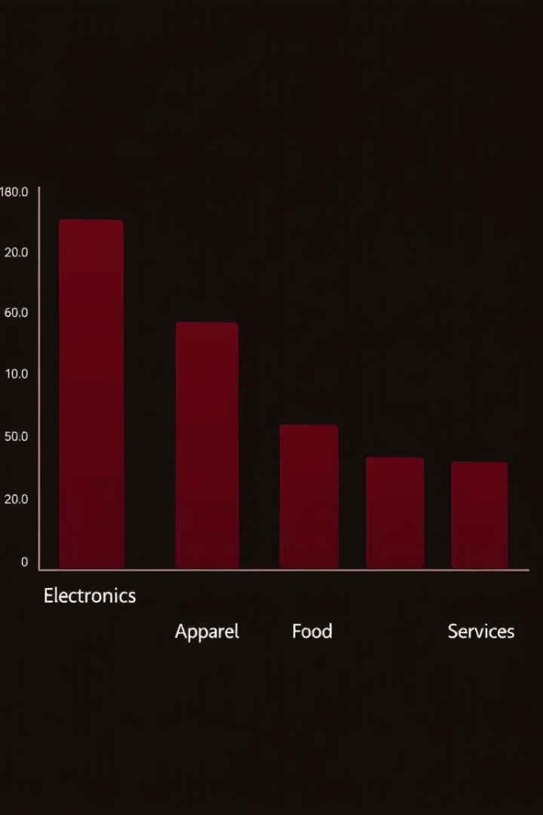


Category and Product Performance
Top Revenue Categories
Electronics, Apparel, and Home Goods drive significant sales.
Least Profitable Sub-Categories
Careful review is needed for these low-margin segments.

Slide 5
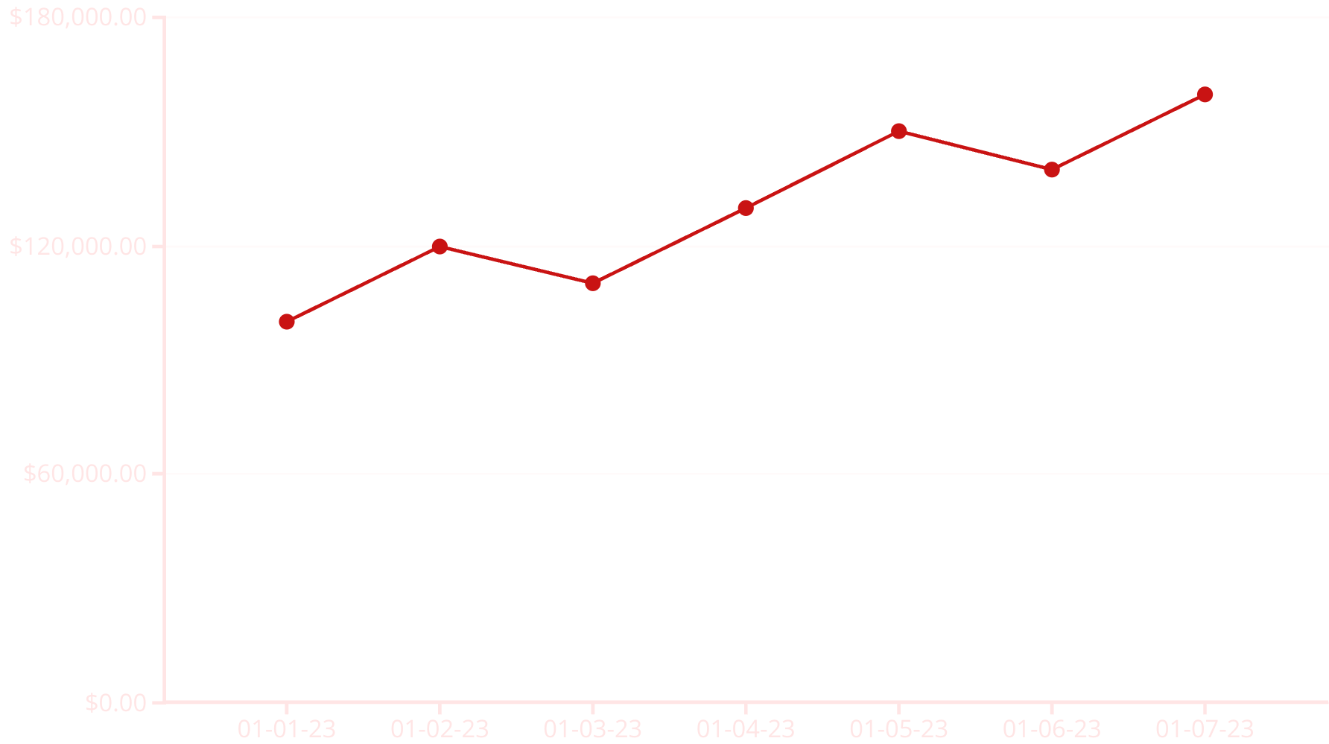
Time-Based Sales Trends
The monthly sales trend shows consistent growth over the period. Sales peak in specific months, indicating seasonal patterns. Understanding these trends helps in inventory and marketing planning.

Slide 6

Geographic Revenue Distribution
State
Revenue
California
$5.2M
New York
$3.8M
Texas
$2.5M
Florida
$2.1M
Illinois
$1.8M
Geographic analysis reveals top-performing states by revenue. California leads, followed by New York and Texas. This data can inform targeted marketing campaigns.

Slide 7
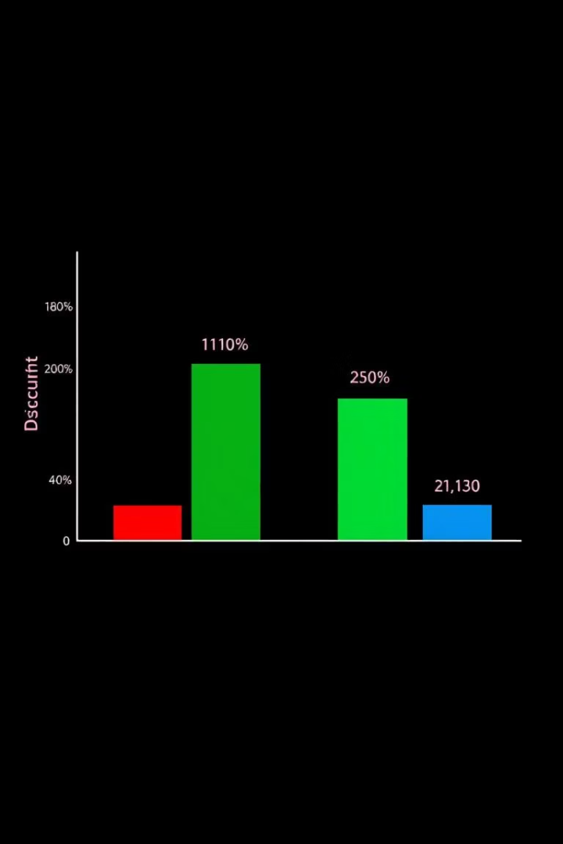
Discount Impact on Profitability
No Discount
Highest profit margins, but potentially lower sales volume.
0-10% Discount
Balanced profit and volume, attractive to most customers.
10-20% Discount
Increased sales, with a moderate reduction in profit per unit.
20%+ Discount
High volume, but significantly reduced profit. Used for clearance.

Slide 8
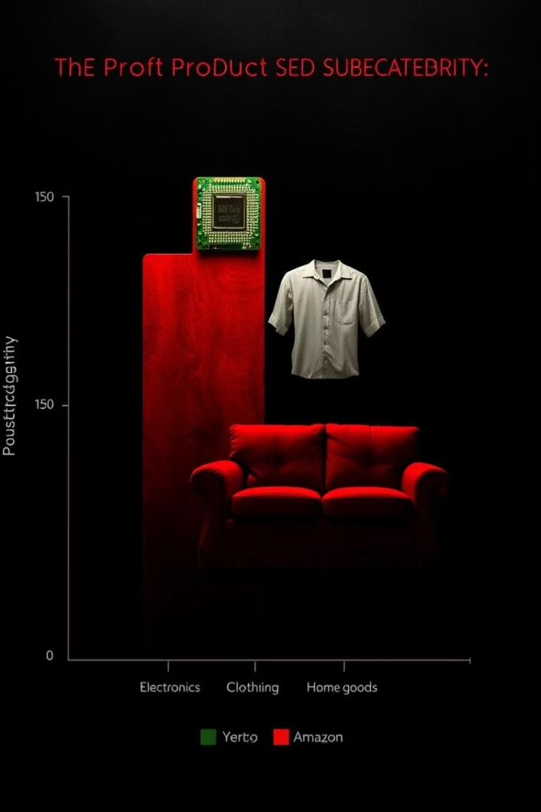




Top Profitable Sub-Categories per Category
Electronics
Laptops, Smartphones, and Smart Home Devices.
Apparel
Outerwear, Footwear, and Accessories.
Home Goods
Furniture, Kitchen Appliances, and Decor.
Books
Fiction, Non-Fiction, and Children's Books.
Identifying top profitable sub-categories per category helps optimize product offerings. This detailed breakdown ensures focus on high-yield products across all segments.

